Slide 1
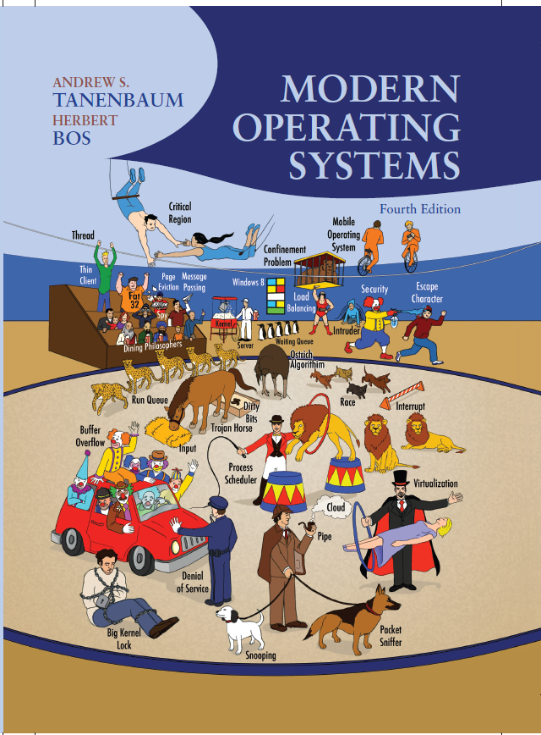
Modern Operating Systems
Fourth Edition
Operating System
Security and Networks
Copyright © 2014 Pearson Education, Inc. All Rights Reserved
Notes:
If this PowerPoint presentation contains mathematical equations, you may need to check that your computer has the following installed:
1) MathType Plugin
2) Math Player (free versions available)
3) NVDA Reader (free versions available)

Slide 2
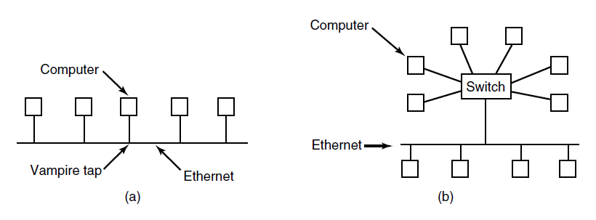
Network Hardware Ethernet
Figure 8-28. (a) Classic Ethernet. (b) Switched Ethernet.

Slide 3
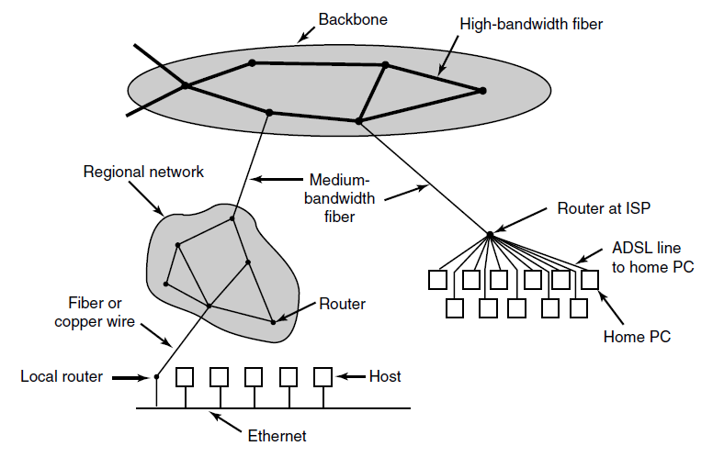
The Internet
Figure 8-29. A portion of the Internet.

Slide 4
Network Services (1 of 2)
Six different types of network service.
Connection Oriented
Service | Example
Reliable message stream | Sequence of pages of a book
Reliable byte stream | Remote login
Unreliable Connection | Digitized voice

Slide 5
Network Services (2 of 2)
Six different types of network service.
Connectionless
Service | Example
Unreliable datagram | Network test packets
Acknowledged datagram | Registered mails
Request-reply | Database query

Slide 6
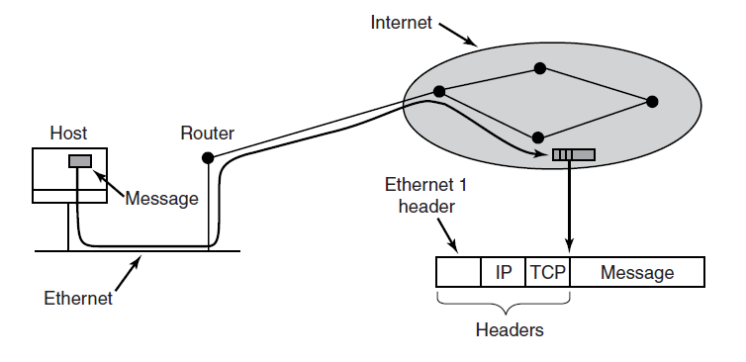
Network Protocols
Figure 8-31. Accumulation of packet headers.

Slide 7
Document-Based Middleware (2 of 3)
For the browser to get the page
http://www.minix3.org/getting-started/index.html
  Browser asks D N S for I P address of www.minix3.org
  D N S replies with 66.147.238.215
  Browser makes a T C P connection to port 80 on 66.147.238.215
  Browser sends a request asking for the file
  getting-started/index.html

Slide 8
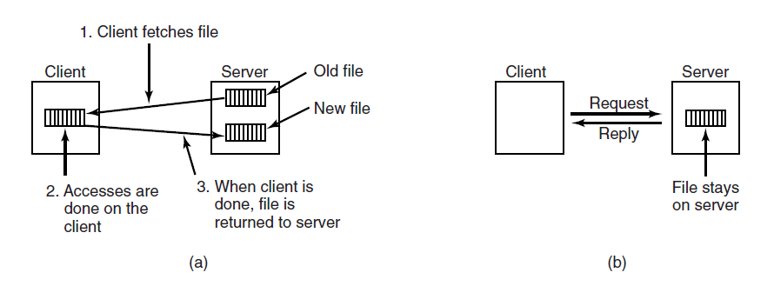
File-System-Based Middleware: Transfer Model
Figure 8-33. (a) The upload/download model. (b) The remote access model.

Slide 9
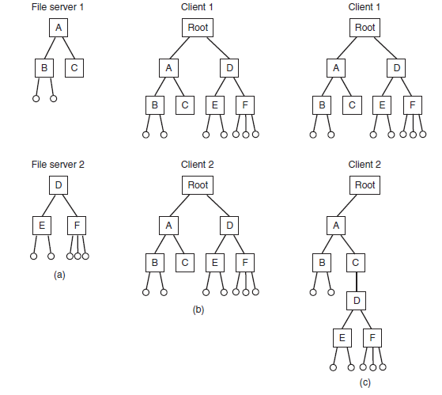
The Directory Hierarchy
Figure 8-34. (a) Two file servers. The squares are directories and the circles are files. (b) A system in which all clients have the same view of the file system. (c) A system in which different clients may have different views of the file system.

Slide 10
Naming Transparency
Common approaches to file and directory naming in a distributed system:
  Machine + path naming, such as /machine/path or machine:path.
  Mounting remote file systems onto the local file hierarchy.
  A single name space that looks the same on all machines.

Slide 11
The Security Environment Threats
Security goals and threats.
Goal | Threat
Confidentiality | Exposure of data
Integrity | Tampering with data
Availability | Denial of service

Slide 12
Can We Build Secure Systems?
Two questions concerning security:
  Is it possible to build a secure computer system?
  If so, why is it not done?

Slide 13
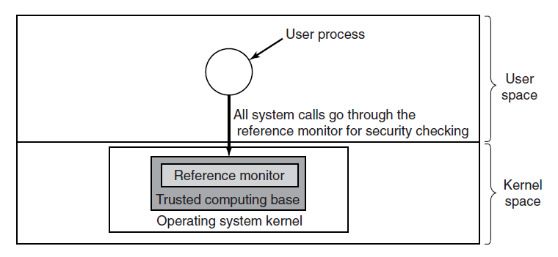
Trusted Computing Base
Figure 9-2. A reference monitor.

Slide 14
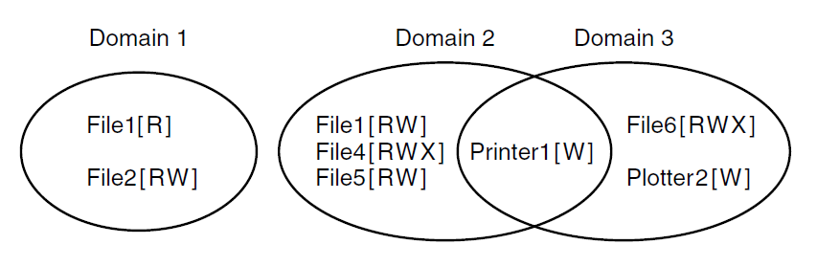
Protection Domains (1 of 3)
Figure 9-3. Three protection domains.

Slide 15
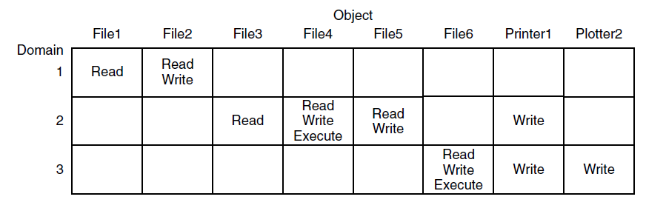
Protection Domains (2 of 3)
Figure 9-4. A protection matrix.

Slide 16
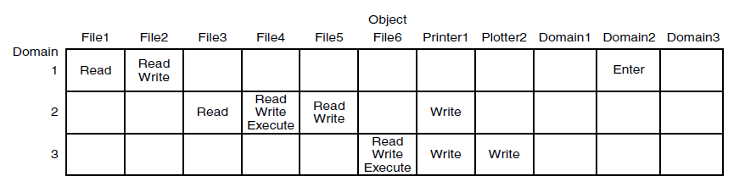
Protection Domains (3 of 3)
Figure 9-5. A protection matrix with domains as objects.

Slide 17
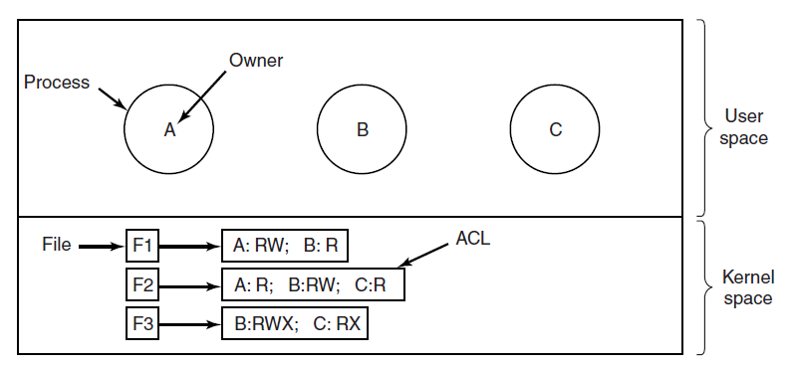
Access Control Lists (1 of 2)
Figure 9-6. Use of access control lists to manage file access.

Slide 18
Access Control Lists (2 of 2)
Use of access control lists to manage file access.
File | Access control list
Password | Tana,sysadm: R W
Pigeon_data | Bill,pigfan: R W; tana,pigfan: R W; …

Slide 19
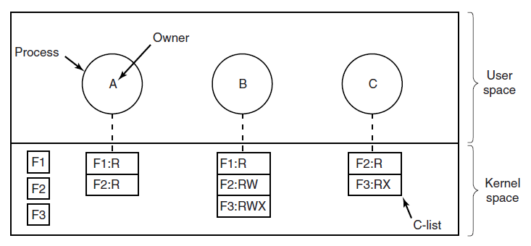
Capabilities (1 of 3)
Figure 9-8. When capabilities are used, each process has a capability list.

Slide 20
Capabilities (2 of 3)
A cryptographically protected capability.
Server | Object | Rights | Function of objects, rights and check

Slide 21
Capabilities (3 of 3)
Examples of generic rights:
  Copy capability: create new capability for same object.
  Copy object: create duplicate object with new capability.
  Remove capability: delete entry from C-list; object unaffected.
  Destroy object: permanently remove object and capability.

Slide 22
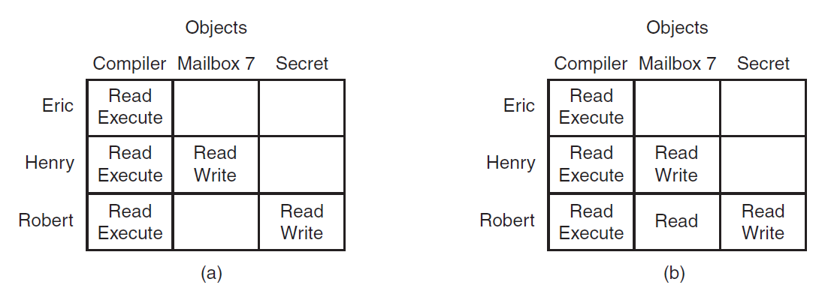
Formal Models of Secure Systems
Figure 9-10. (a) An authorized state. (b) An unauthorized state.

Slide 23
Multilevel Security: Bell-LaPadula Model
Bell-LaPadula Model rules for information flow:
  The simple security property
    Process running at security level k can read only objects at its level or lower
  The * property
    Process running at security level k can write only objects at its level or higher

Slide 24
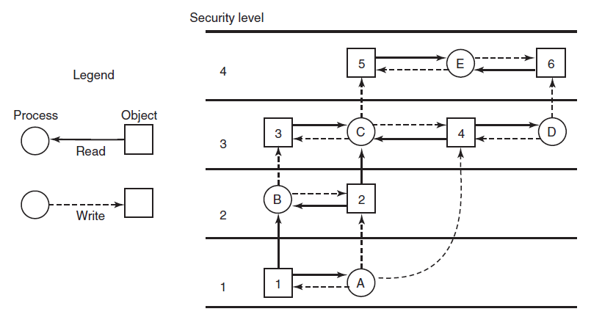
Bell- LaPadula Model
Figure 9-11. The Bell-LaPadula multilevel security model.

Slide 25
The Biba Model
To guarantee the integrity of the data:
  The simple integrity principle
    process running at security level k can write only objects at its level or lower (no write up).
  The integrity * property
    process running at security level k can read only objects at its level or higher (no read down).

Slide 26
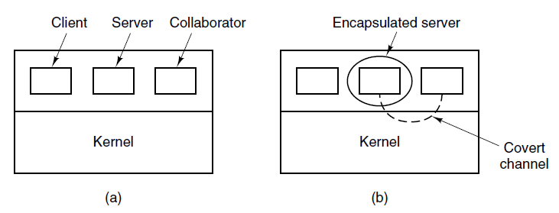
Covert Channels (1 of 2)
Figure 9-12. (a) The client, server, and collaborator processes. (b) The encapsulated server can still leak to the collaborator via covert channels.

Slide 27
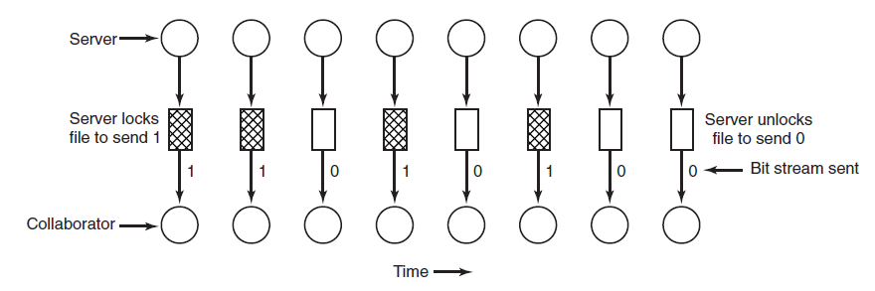
Covert Channels (2 of 2)
Figure 9-13. A covert channel using file locking.

Slide 28
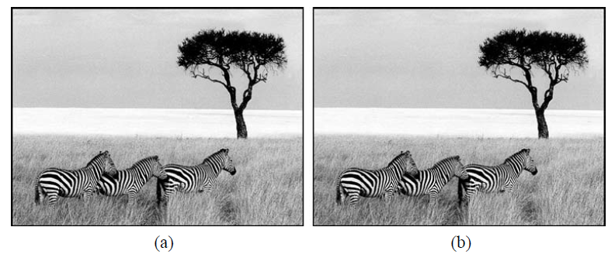
Steganography
Figure 9-14. (a) Three zebras and a tree. (b) Three zebras, a tree, and the complete text of five plays by William Shakespeare.

Slide 29
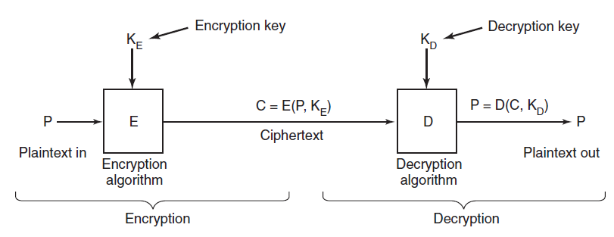
Basics of Cryptography
Figure 9-15. Relationship between the plaintext and the ciphertext.

Slide 30
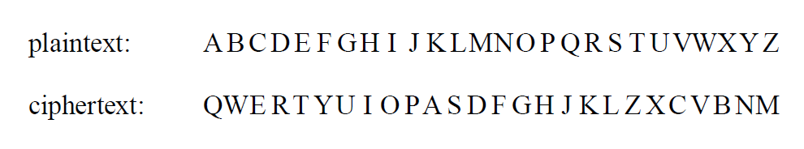
Secret-Key Cryptography
An encryption algorithm in which each letter is replaced by a different letter.

Slide 31
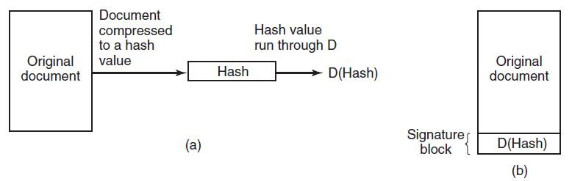
Digital Signatures
Figure 9-16. (a) Computing a signature block. (b) What the receiver gets.

Slide 32
Authentication (1 of 2)
Methods of authenticating users when they
attempt to log in based on one of three general principles:
  Something the user knows.
  Something the user has.
  Something the user is.

Slide 33
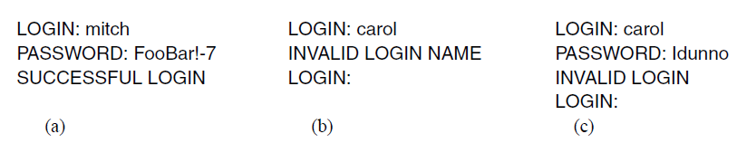
Authentication (2 of 2)
Figure 9-17. (a) A successful login. (b) Login rejected after name is entered. (c) Login rejected after name and password are typed.

Slide 34
U N I X Password Security
(a) A successful login. (b) Login rejected after name is entered. (c) Login rejected after name and password are typed.
Bobbie, 4238, e(Dog, 4238)
Tony, 2918, 2918)
Laura, 6902, e(Shakespeare, 6902)
Mark, 1694, e(XaB#Bwcz, 1694)
Deborah, 1092, e(LordByron,1092)

Slide 35
Challenge-Response Authentication
Questions should be chosen so that the user does not need to write them down.
Examples:
  Who is Marjolein’s sister?
  On what street was your elementary school?
  What did Mrs. Ellis teach?

Slide 36
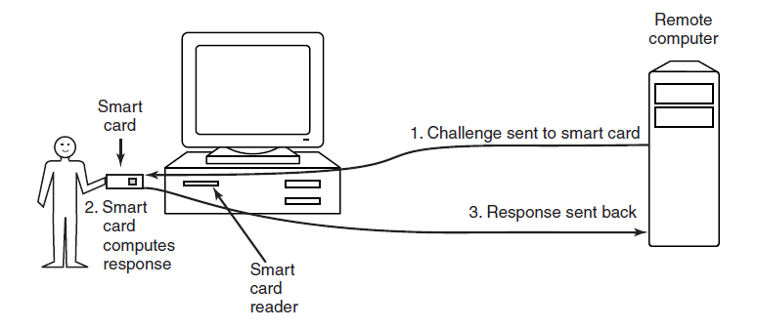
Authentication Using a Physical Object
Figure 9-19. Use of a smart card for authentication.

Slide 37
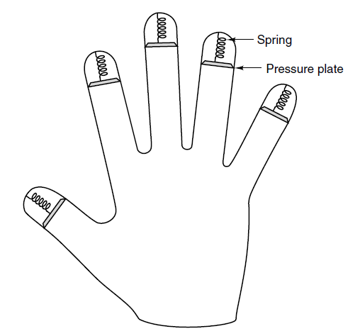
Authentication Using Biometrics
Figure 9-20. A device for measuring finger length.

Slide 38
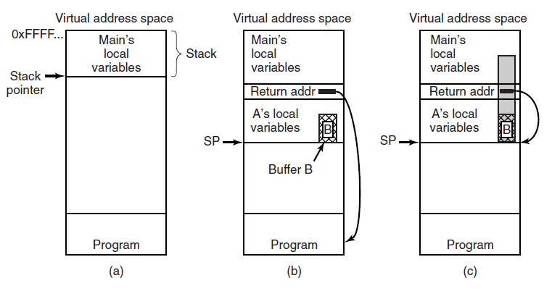
Buffer Overflow Attacks
Figure 9-21. (a) Situation when the main program is running. (b) After the procedure A has been called. (c) Buffer overflow shown in gray.

Slide 39
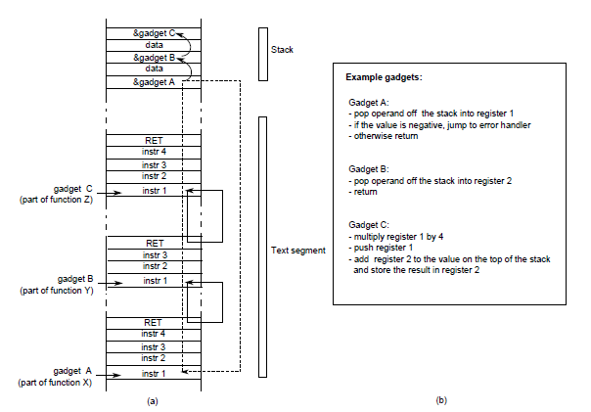
Code Reuse Attacks
Figure 9-23. Return-oriented programming: linking gadgets

Slide 40
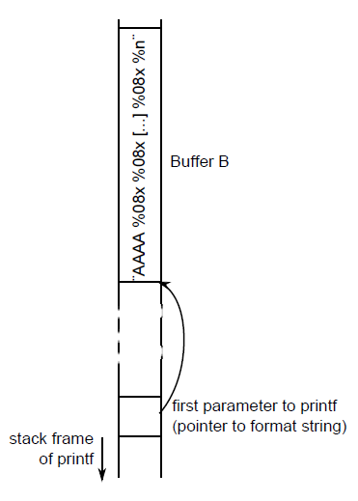
Format String Attacks
Figure 9-24. A format string attack. By using exactly the right number of %08x, the attacker can use the first four characters of the format string as an address.

Slide 41
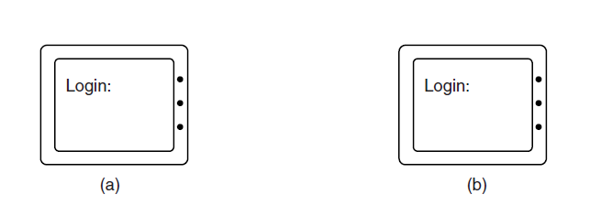
Login Spoofing
Figure 9-27. (a) Correct login screen. (b) Phony login screen.

Slide 42
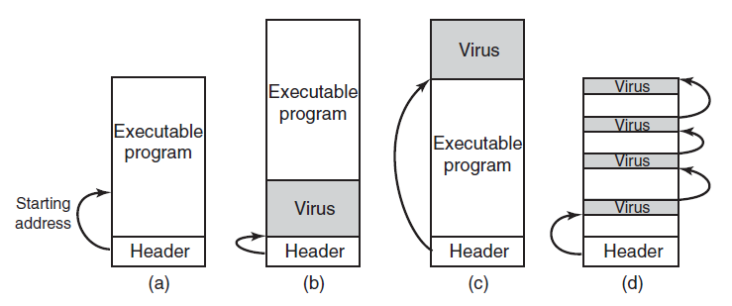
Executable Program Viruses (3 of 3)
Figure 9-29. (a) An executable program. (b) With a virus at the front. (c) With a virus at the end. (d) With a virus spread over free space within the program.

Slide 43
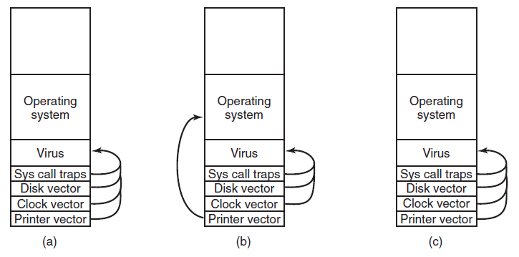
Boot Sector Viruses
Figure 9-30. (a) After the virus has captured all the interrupt and trap vectors. (b) After the operating system has retaken the printer interrupt vector. (c) After the virus has noticed the loss of the printer interrupt vector and recaptured it.

Slide 44
Actions Taken by Spyware (1 of 2)
Change the browser’s home page.
Modify the browser’s list of favorite (bookmarked) pages.
Add new toolbars to the browser.
Change the user’s default media player.
Change the user’s default search engine.

Slide 45
Actions Taken by Spyware (2 of 2)
Add new icons to the Windows desktop.
Replace banner ads on Web pages with those the spyware picks.
Put ads in the standard Windows dialog boxes
Generate a continuous and unstoppable stream of pop-up ads.

Slide 46
Types of Rootkits (1 of 2)
Five kinds of rootkits – issue is where do they hide?
  Firmware rootkit
  Hypervisor rootkit
  Kernel rootkit
  Library rootkit
  Application rootkit

Slide 47
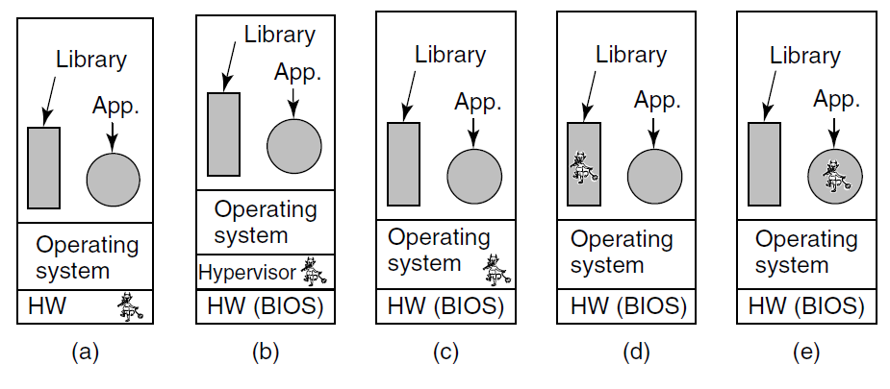
Types of Rootkits (2 of 2)
Figure 9-31. Five places a rootkit can hide.

Slide 48
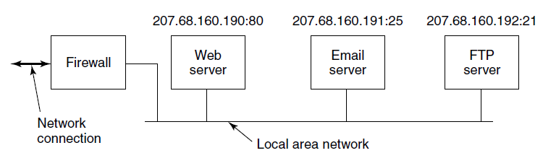
Firewalls
Figure 9-32. A simplified view of a hardware firewall protecting a LAN with three computers

Slide 49
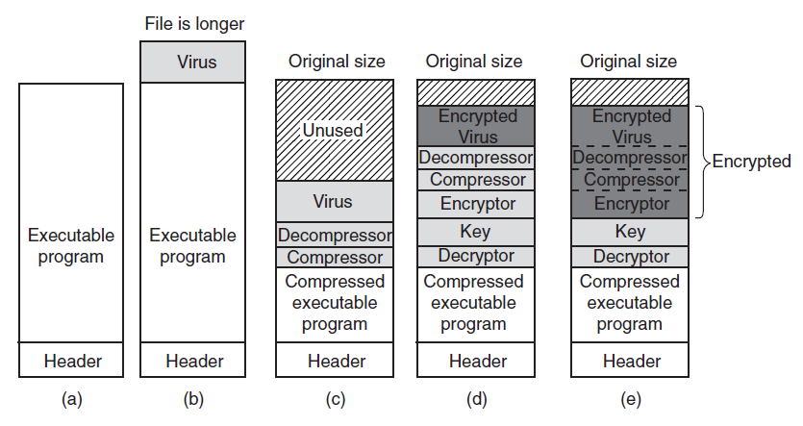
Virus Scanners (1 of 2)
Figure 9-33. (a) A program. (b) An infected program. (c) A compressed infected program. (d) An encrypted virus. (e) A compressed virus with encrypted compression code.

Slide 50
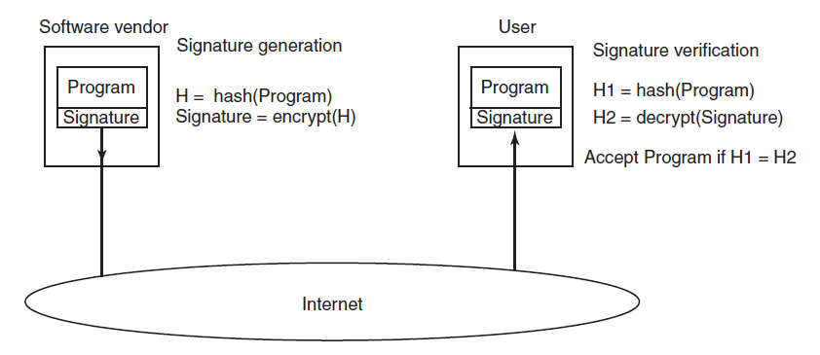
Code Signing
Figure 9-35. How code signing works.

Slide 51
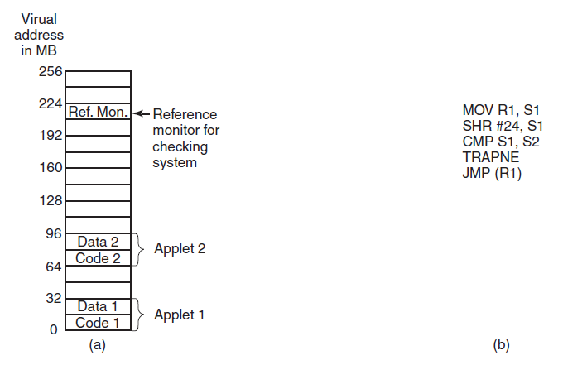
Sandboxing
Figure 9-38. (a) Memory divided into 16-MB sandboxes. (b) One way of checking an instruction for validity.

Slide 52
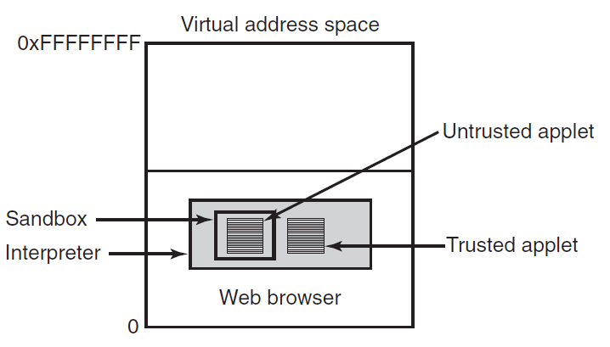
Interpretation
Figure 9-39. Applets can be interpreted by a Web browser.

Slide 53
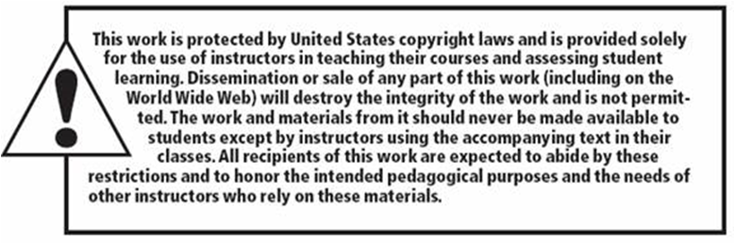
Copyright

